Slide 1
UNIT-III
Production Analysis

Slide 2
Production
Production is an organised activity of transforming inputs into outputs to satisfy the demand for commodities and services of the community.
Inputs refer to all those things, which a firm buys and employs to produce a particular product.
Output means the quantity of goods in the finished form produced by the firm for selling.
The Money expenses incurred in the process of production, i.e., transforming resources into finished product constitute the Cost of Production.

Slide 3
Inputs are technically called as Factors of Production
Factors of Production:
LAND
LABOUR
CAPITAL
ORGANISATION

Slide 4
Production Function
The Production Function expresses a functional or technical relationship between physical inputs and physical outputs of a firm at any particular time period.
The output is thus a function of inputs.
Mathematically Production function can be written as:
Q = f (Land, Labour, Capital & Organisation)
Where Q stands for the quantity of output produced by the firm and on the other side whatever is available they are the factors of production.

Slide 5
Assumptions of Production Function
The Production Function is related to a particular period of time.
There is no change in technology
The producer is using the best technique available
The factors of production are divisible
Production function can be fitted to a short run or to long run

Slide 6
Importance of Production Function
When inputs are specified in physical units, Production Function helps to estimate the level of production.
With the help of Isoquants, Production Function explains the different combinations of inputs which will yield the same level of output.
Production Function indicates the manner in which the firm can substitute one input for another without altering the total output.
When price is taken into consideration, the Production Function helps to select the least cost combination of inputs for desired output.
It considers the two types of input-output relationships, namely: Law of Variable Proportions and Law of returns to scale.
Law of Variable Proportions explains the pattern of output in short-run and Law of returns to scale explains the pattern of output during the long-run.

Slide 7
Units
of
Capital
Units of Labour
4 | 200 | 240 | 290 | 320
3 | 150 | 200 | 240 | 290
2 | 100 | 150 | 200 | 240
1 | 50 | 100 | 150 | 200
Units | 1 | 2 | 3 | 4

Slide 8
ISOQUANTS
While studying the concept of ISOQUANTS, the general Production Function is reduced to only two input factors.
Q = f (L, K)
The above function has 3 variable; Output of Commodity Q, Units of Labour (L) and Units of Capital (K).
For a given value of Q, there will be alternative combinations of L and K.
Though both labour and capital are necessary for the production of commodity, they are substitutes to each other. So we get alternative combinations of inputs dealing with the same output.

Slide 9
Q₁ = 10 tons
K | L
1 | 20
2 | 12
3 | 8
4 | 6
5 | 4
6 | 3
Q₂ = 20 tons
K | L
2 | 20
3 | 14
4 | 10
5 | 7
6 | 5
7 | 4

Slide 10
An Isoquant is the locus of all those alternative combinations of labour and capital, which yield the same output.
An isoquant is a curve that shows all the combinations of inputs that yield the same level of output.
‘Iso’ means equal and ‘quant’ means quantity. Therefore, an isoquant represents a constant quantity of output.
The isoquant curve is also known as an “Equal Product Curve” or “Production Indifference Curve” or Iso-Product Curve.”

Slide 11
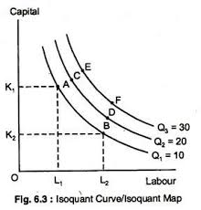
ISOQUANT CURVE

Slide 12
Properties of an Isoquants
They are falling downwards curves
The higher the Isoquants is, higher the output it represents
They do not intersect each other
They are convex from below
They do not touch either X or Y axis

Slide 13
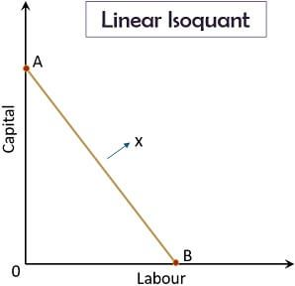
Types of Isoquants
Linear Isoquant:
It represents perfect
Substitutability of
Factors of production.

Slide 14
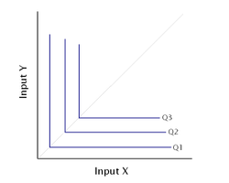
2. Input-Output-Isoquant:
This shows zero substitution
between input factors.

Slide 15
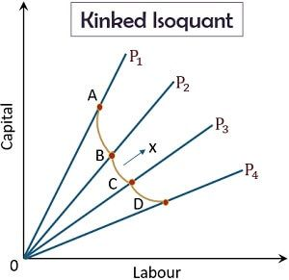
3. Kinked Isoquant:
If the factors of
Production show limited
Substitution between input
Factors then we get this.

Slide 16
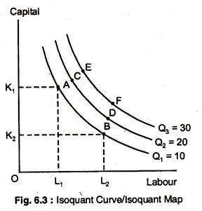
4. Smooth Convex Isoquant:
This form assumes
Continuous substitutability
of factors of production.

Slide 17
Least cost combination of inputs
The Isoquant curve indicates the alternative combinations of various factors of production, which can produce a given output.
Of these, the firm would like to choose that combination of input factors, which would cost the least.
For this we may have to consider the price of input factors, i.e, price of labour and price of capital.

Slide 18
Example:
In this example, there are 6 alternative combinations of labour and capital to produce the given produce say 9 quintals.
Let the price of labour be Rs. 6 per unit and
Price of capital Rs. 9 per unit.
Combinations | K (Units of Capital) | L (Units of labour) | Total Cost (Rs)
1 | 3 | 20 | 3 x 9 + 20 x 6 = 147
2 | 4 | 13 | 4 x 9 + 13 x 6 = 114
3 | 5 | 10 | 5 x 9 + 10 x 6 = 105
4 | 6 | 8 | 6 x 9 + 8 x 6 = 102
5 | 7 | 6 | 7 x 9 + 6 x 6 = 99
6 | 8 | 5 | 8 x 9 + 5 x 6 = 102

Slide 19
Graphically we can determine the least cost input combination or the maximum output for a given cost.
For this we may have to draw Isoquant and Isocost curves.
By superimposing Isoquant curve on the Isocost curve we can get the same least cost combination of inputs for producing the desired produce.

Slide 20
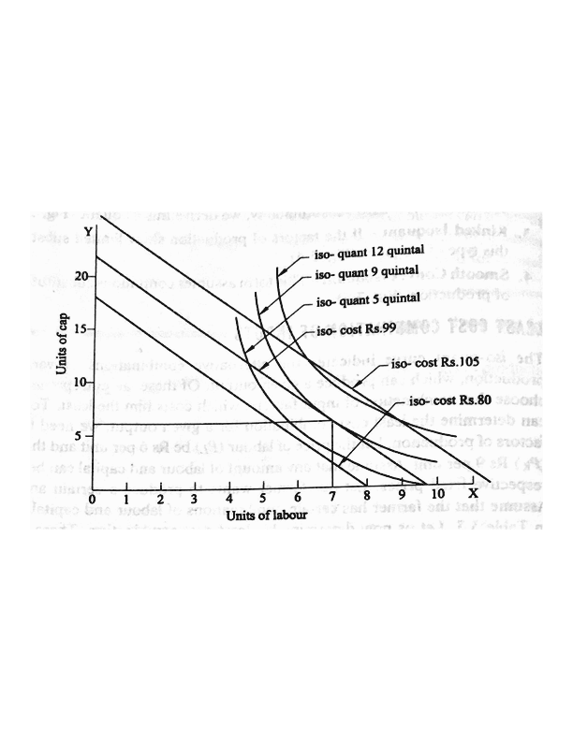

Slide 21
Law of Variable Proportions/Law of Diminishing Marginal Utility
The Law of Variable Proportions explains the input-output relation, during short period. The short-run is a period in which at least one input will be fixed.
It deals with the change in output due to the change in variable inputs. I.e., the increase in production is possible only by increasing the variable inputs.
When variation is made only in one/some factors keeping the other factors fixed, the proportion between the fixed factors and the variable factors is varied, hence the study is called the Law of Variable Proportions.
The Law, as it brings diminishing tendency in production, is also known as the Law of Diminishing Marginal Utility.

Slide 22
The Law states that when some factors remain constant, if more and more units of a variable factors are introduced to increase the Production;
The production may increase initially at an increasing rate, but after a point it increases only at a diminishing rate, and finally output also reduces.
We find 3 stages here: (output will be responding in 3 ways)
Increasing returns to scale: output increases at an increasing rate
Diminishing/decreasing returns to scale: output increases at a diminishing rate
Negative returns to scale: output declines.
First and last stages are referred as irrational stages and only second stage is called as rational stage.

Slide 23
Illustration:
Number of workers | Total Product | Average Product | Marginal Product
1 | 10 | 10 | -
2 | 22 | 11 | 12
3 | 36 | 12 | 14
4 | 52 | 13 | 16
5 | 66 | 13.2 | 14
6 | 76 | 12.7 | 10
7 | 82 | 11.7 | 6
8 | 85 | 10.6 | 3
9 | 85 | 9.4 | 0
10 | 83 | 8.3 | -2

Slide 24
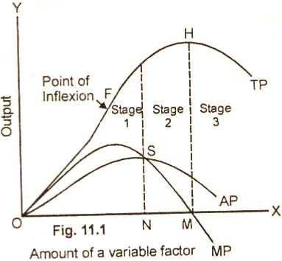

Slide 25
Assumptions of the Law of Variable Proportions
The Law is based on the following assumptions:
The Production technology remain unchanged
Homogeneous variable factors
At least one input is fixed
The fixed input is indivisible

Slide 26
Law of Returns to Scale
The Law of returns to scales deals with the pattern of output in the long-run.
In the long-run all the factors of production are variable, and an increase in output is possible by increasing all the inputs.
The firm can have large quantities of inputs and expand the scale of production.
So the law explains the technological relationship between changing scale of inputs and outputs.
Returns to scale implies the change in output or returns when all the factors are changed simultaneously in the same ratio.

Slide 27
When all the inputs are increased, output naturally increases.
However even here we find output responding in 3 different ways.
We find 3 stages:
Increasing returns to scale stage: the proportionate change in output is more than the proportionate change in inputs
Constant returns to scale stage: the proportionate change in output is equal to that of the change in input factors.
Decreasing returns to scale stage: the proportionate change is output is slightly lower than the change in input factors.

